Slide 1
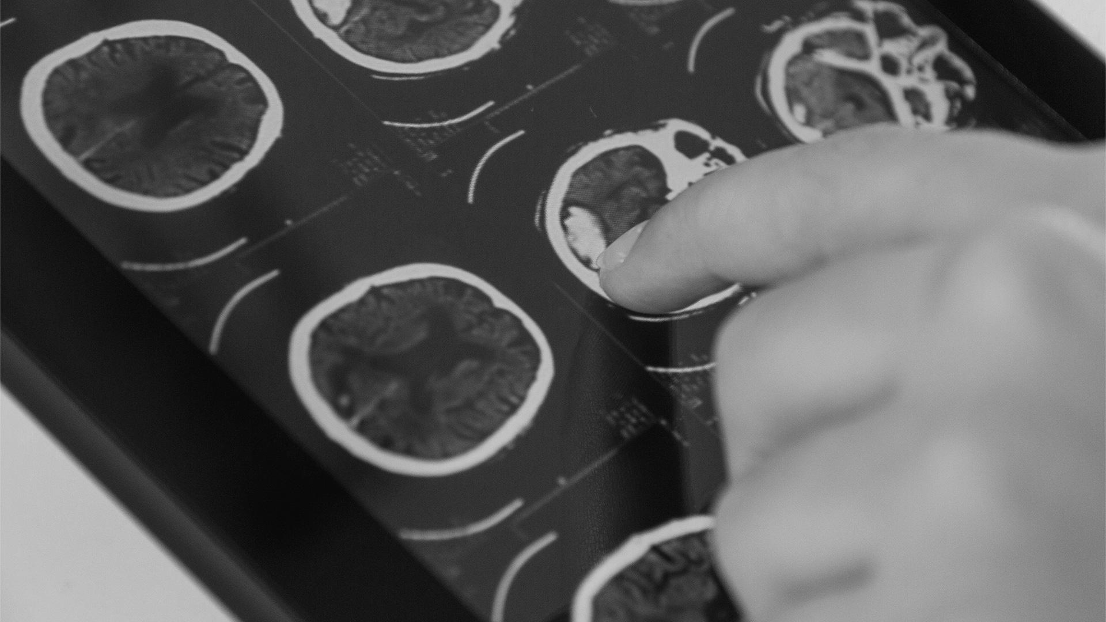
CERVICAL CANCER DETECTION
By: Quoc Tuong Lukas Dong
Data Mining

Slide 2

INTRODUCTION
11,000 new annual cases of invasive cervical cancers in US.
4,000 deaths in US
300,000 deaths globally.

Slide 3
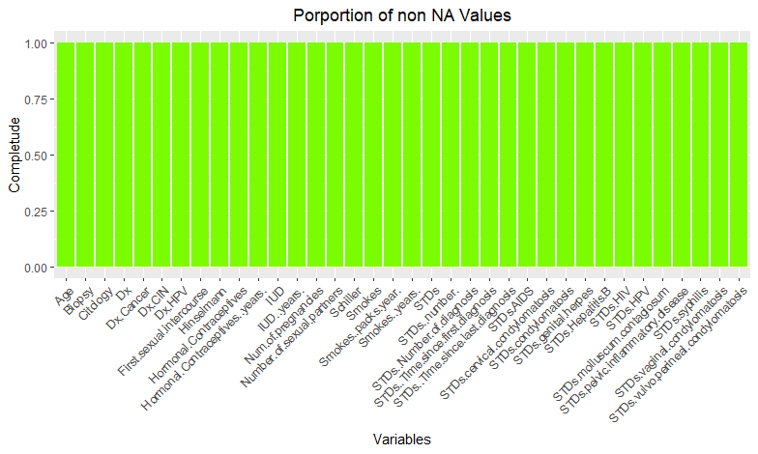
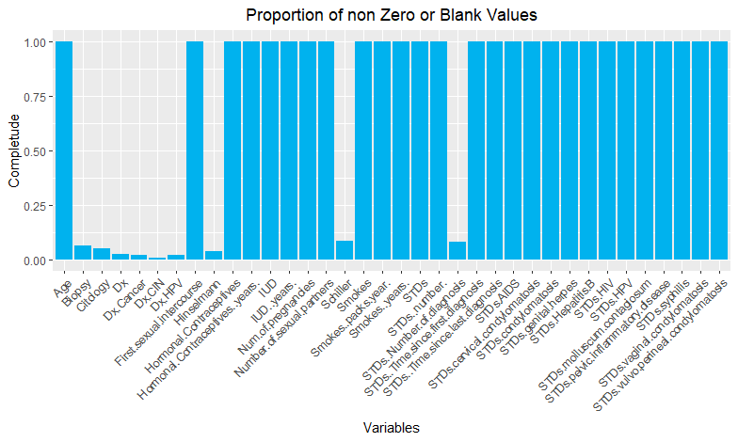
Cervical Cancer (Risk Factors) from UCI
The dataset was collected at 'Hospital Universitario de Caracas' in Caracas, Venezuela.
858 inputs with 36 variables ranging from demographic information, habits to historic medical records

Slide 4
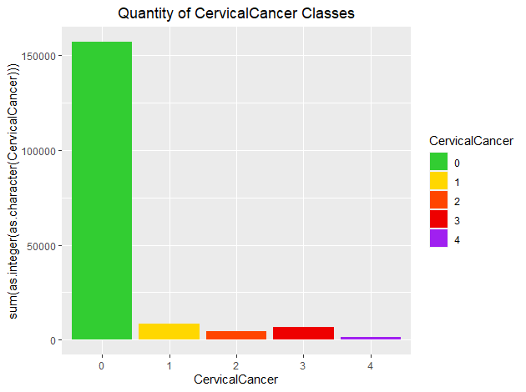


$$CervicalCancer=$$
$$Hinselmann+Schiller+Citology+Biopsy$$

Slide 5
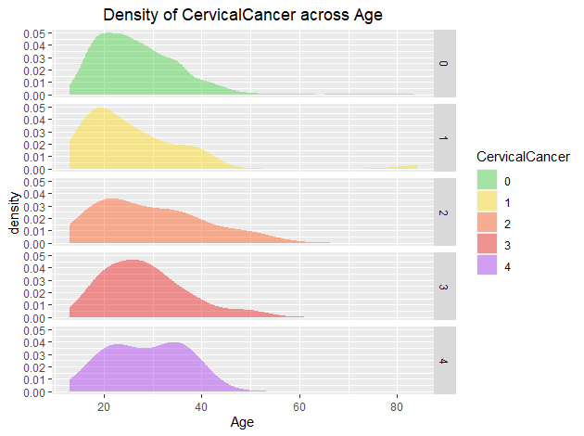
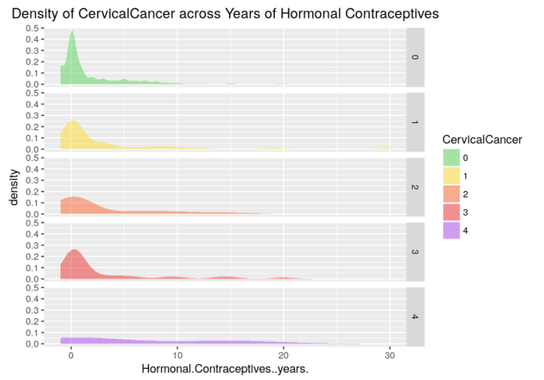

Slide 6
Feature Importance with Boruta
Adds randomness to the given data set by creating shuffled copies of all features
Trains a random forest classifier on the extended data set and applies a feature importance measure
Check at every iteration whether a real feature has a higher importance than the best of its randomized features
Stops either when all features gets confirmed or rejected or it reaches a specified limit of random forest runs.
➔ Confirmed 15, Rejected 7, Tentative 10

Slide 7
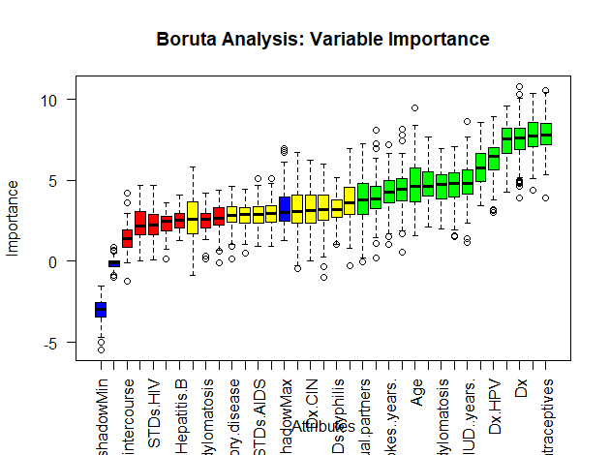
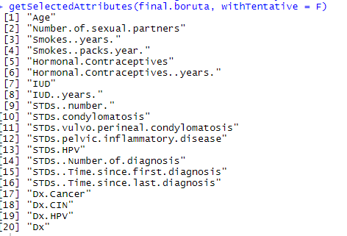

Slide 8
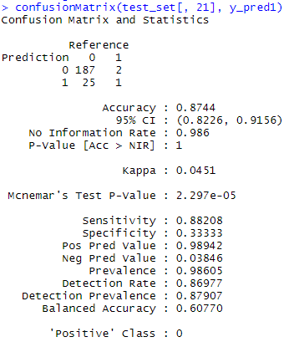
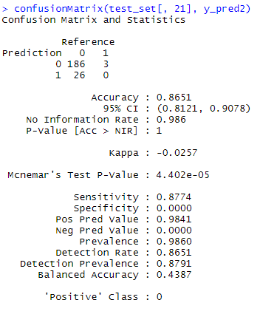
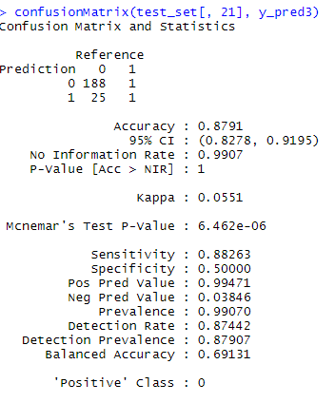
PREDICTION MODELS
01
02
03
Support Vector Machine
Decision Tree
Random Forest

Slide 9
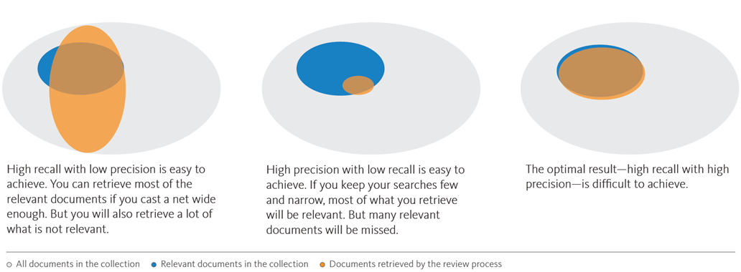
Recall is more important than precision because the cost of wrong treatment might be high, but not at high as the opportunity cost of wrongly passing up a potential cancer patient.
➔ Choose Random forest method due to the fact that it has the highest Recall rate (0.8826) and Precision rate (0.5)

